Slide 1
Chapter 1
Modeling Change

Slide 2
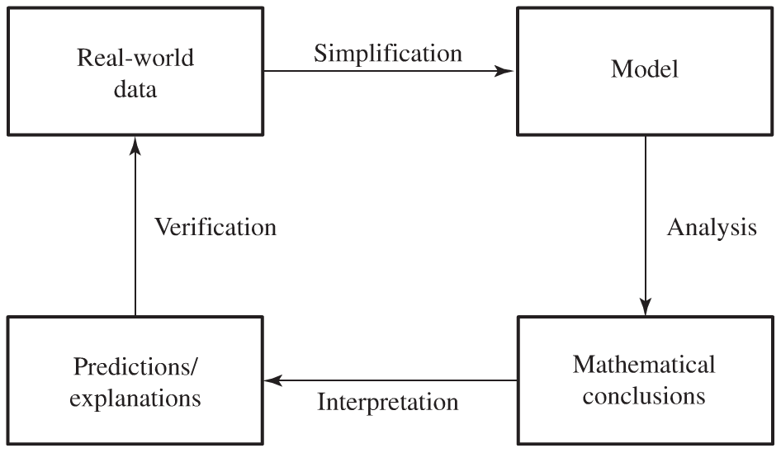
Mathematical Models
Mathematical construct designed to study a particular real-world system or behavior of interest.

Slide 3
Proportionality
Examples
Cylindrical containers
Strength
Flea Jump

Slide 4
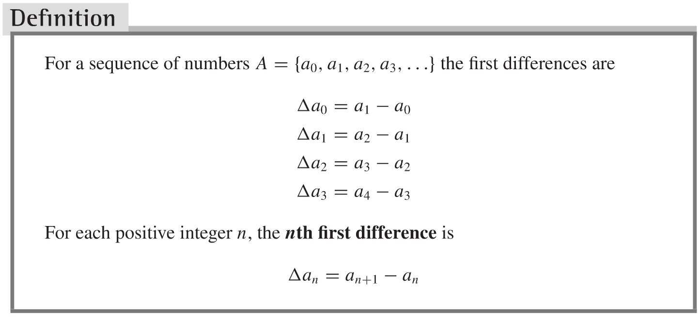
1.1 Modeling Change with Difference Equations
Change is modeled in discrete intervals:

Slide 5
Examples
A Savings Certificate
Dynamical System that models the behavior
Mortgaging a Home
Dynamical System

Slide 6
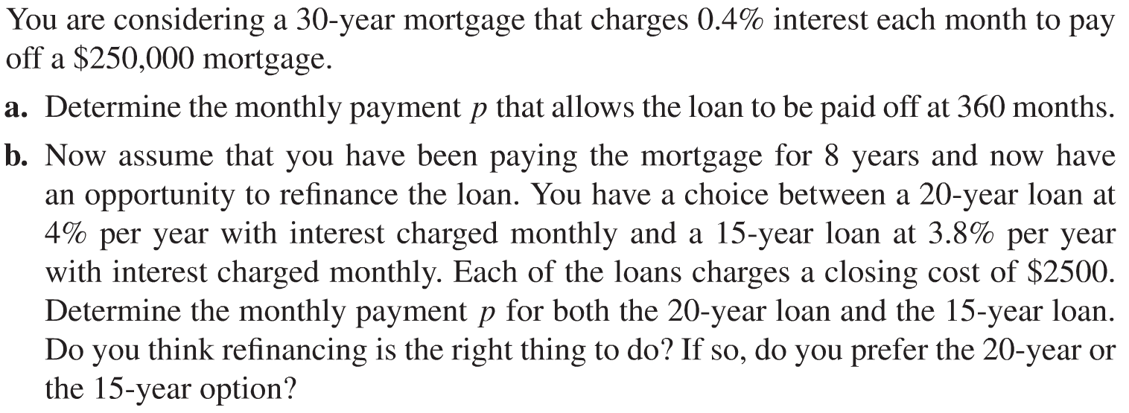
Project
Mortgage Payment

Slide 7
1.2 Approximating Change with Difference Equations
We can approximate a continuous change by examining data taken at discrete time intervals.
Examples
Population Growth
Unbounded
Carrying Capacity

Slide 8
Example
Yeast Growth Spreadsheet

Slide 9
Examples
Spread of a Contagious Disease
Increase in the number of infected people depends on the number of interactions between those infected and those not infected
Law of cooling

Slide 10
Homework (Due Wed 09/05/12)
Page 7
Problems # 1, 2, 3, 4, 5, 9
Page 16
Problems # 2, 5, 10, 11
Project
Mortgage Payment (see Section 1.1 slides)

Slide 11
1.3 Solutions to Dynamical Systems
The Method of Conjecture
Observe a pattern.
Conjecture a form of the solution to the dynamical system.
Test the conjecture by substitution.
Accept or reject the conjecture depending on whether it does or does not satisfy the system after the substitution and algebraic manipulation. For the conjecture to be accepted, the substitution must result in an identity.

Slide 12
Linear Dynamical Systems a_{n+1}=ra_{n}, for r Constant

Slide 13
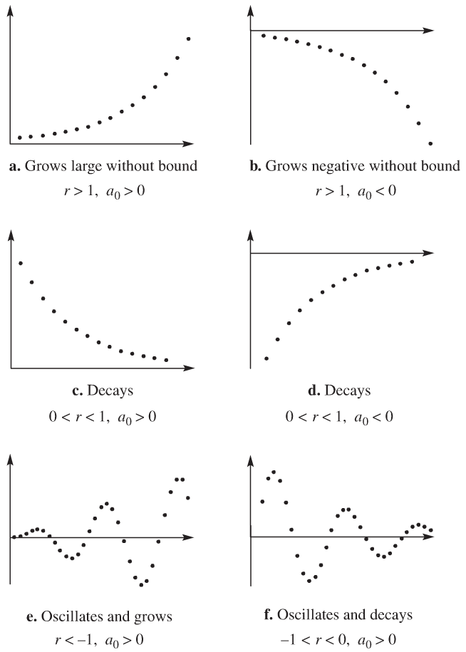
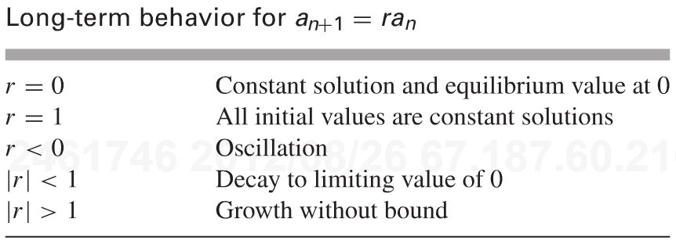
Long-Term Behavior of a_{n+1}=ra_{n}, for r Constant

Slide 14
Dynamical Systems of the form a_{n+1}=ra_{n}+b where r and b are constants
Two case studies:
Drug dosage
a_{n+1}=0.5a_{n}+0.1
Study the behavior of the dynamical system for different initial doses.
Investment Annuity
a_{n+1}=1.01a_{n} - 1000
Study the behavior of the dynamical system for different initial investments.

Slide 15
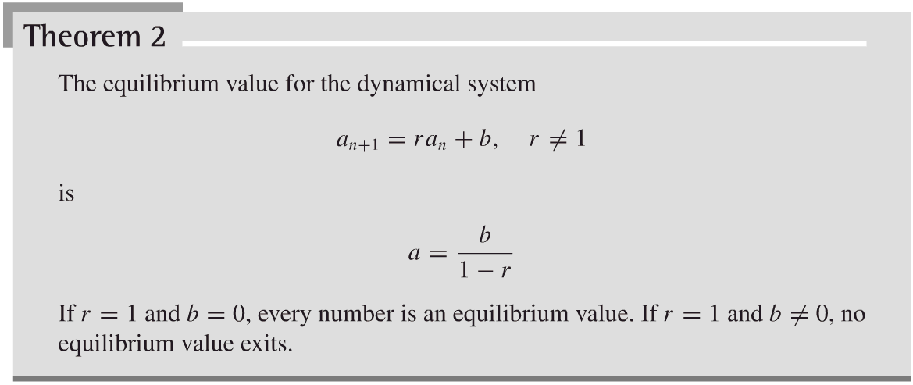
Finding and Classifying Equilibrium Values
Conjecture
The solution to the dynamical system is of the form
a_{k} = r^{k}c + Equil

Slide 16
Solution of the Dynamical System a_{n+1}=ra_{n}+b
Show that the conjecture satisfies the dynamical system in general.

Slide 17
1.4 Systems of Difference Equations
Example
Car Rental Company
Model the dynamical system represented in the diagram
Let O_{n} and T_{n} be the number of cars in Orlando and Tampa at the end of day n.
Assume the company owns 7000 cars
Run a numerical simulation of the dynamical system for different initial conditions

Slide 18
Competitive Hunter Model
Example: Spotted Owls and Hawks
Unconstrained growth
The effect of the presence of the second species is to diminish the growth rate of the other species, and vice versa

Slide 19
Competitive Hunter Model
Example: Spotted Owls and Hawks
O_{n+1} = (1+k₁)O_{n} – k₃O_{n}H_{n}
H_{n+1} = (1+k₂)H_{n} – k₄O_{n}H_{n}
O_{n+1} = 1.2O_{n} – 0.001O_{n}H_{n}
H_{n+1} = 1.3H_{n} – 0.002O_{n}H_{n}
Equilibrium Values

Slide 20
Competitive Hunter Model
Run a numerical simulation of the dynamical system for different initial conditions
Exoplore the system further by examining other starting points and by changing the coefficients of the model

Slide 21
Homework
Page 31
Problems # 1, 2, 3, 4, 6, 13
Page 49
Problems # 1, 2, 4, 7
Project Page 35
Project #2

